Slide 1


Home
Services
Features
About Us
Contact
Telecom Churn Prediction
Using Machine Learning to Improve Customer Retention

Slide 2



Home
Services
Features
About Us
Contact
Project Overview
project goal
Predict churn and understand key drivers to help the company retain customers
Tools used: Python, Pandas, Scikit-learn, Seaborn, etc.

Slide 3





Home
Services
Features
About Us
Contact
Business Problem
Churn:
When customers discontinue their telecom service.
Understanding the Business Problem
Impact
Losing customers is costly; retaining them is more economical.
Objective
Identify customers at high risk of churn and understand why.

Slide 4

Home
Services
Features
About Us
Contact
Dataset Overview
Rows: 7,043
Columns: 21 features + 1 target
Target Variable: Churn (Yes/No)
Key Features:
Contract, Tenure, InternetService
PaymentMethod, MonthlyCharges, Support Services

Slide 5

Home
Services
Features
About Us
Contact
Data Cleaning & Preprocessing
Handled missing values (e.g., TotalCharges)
Converted categorical variables using encoding
Scaled numerical features
Selected top 10 features using feature importance from Decision Tree

Slide 6
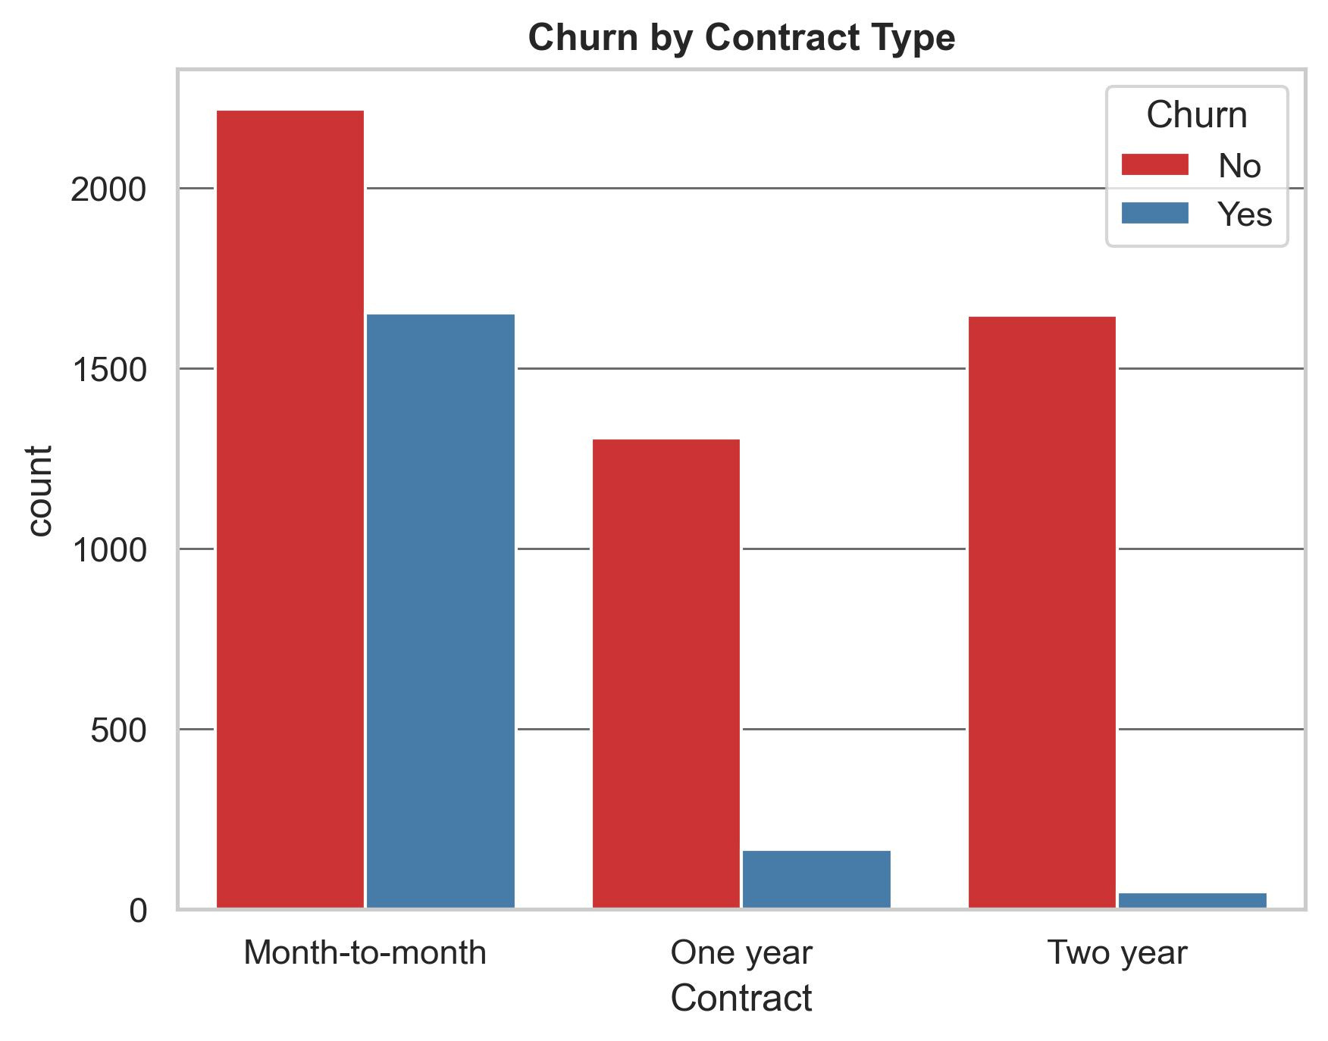
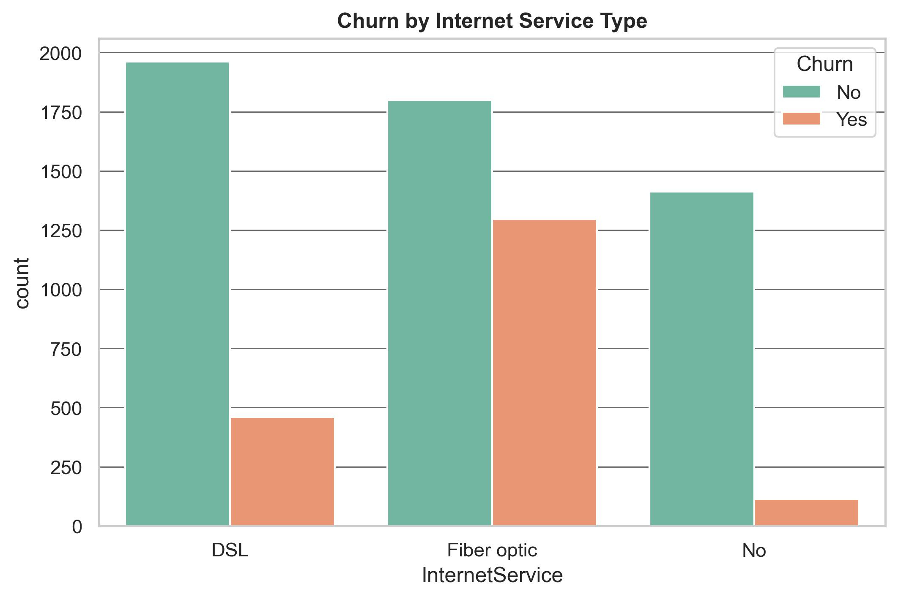
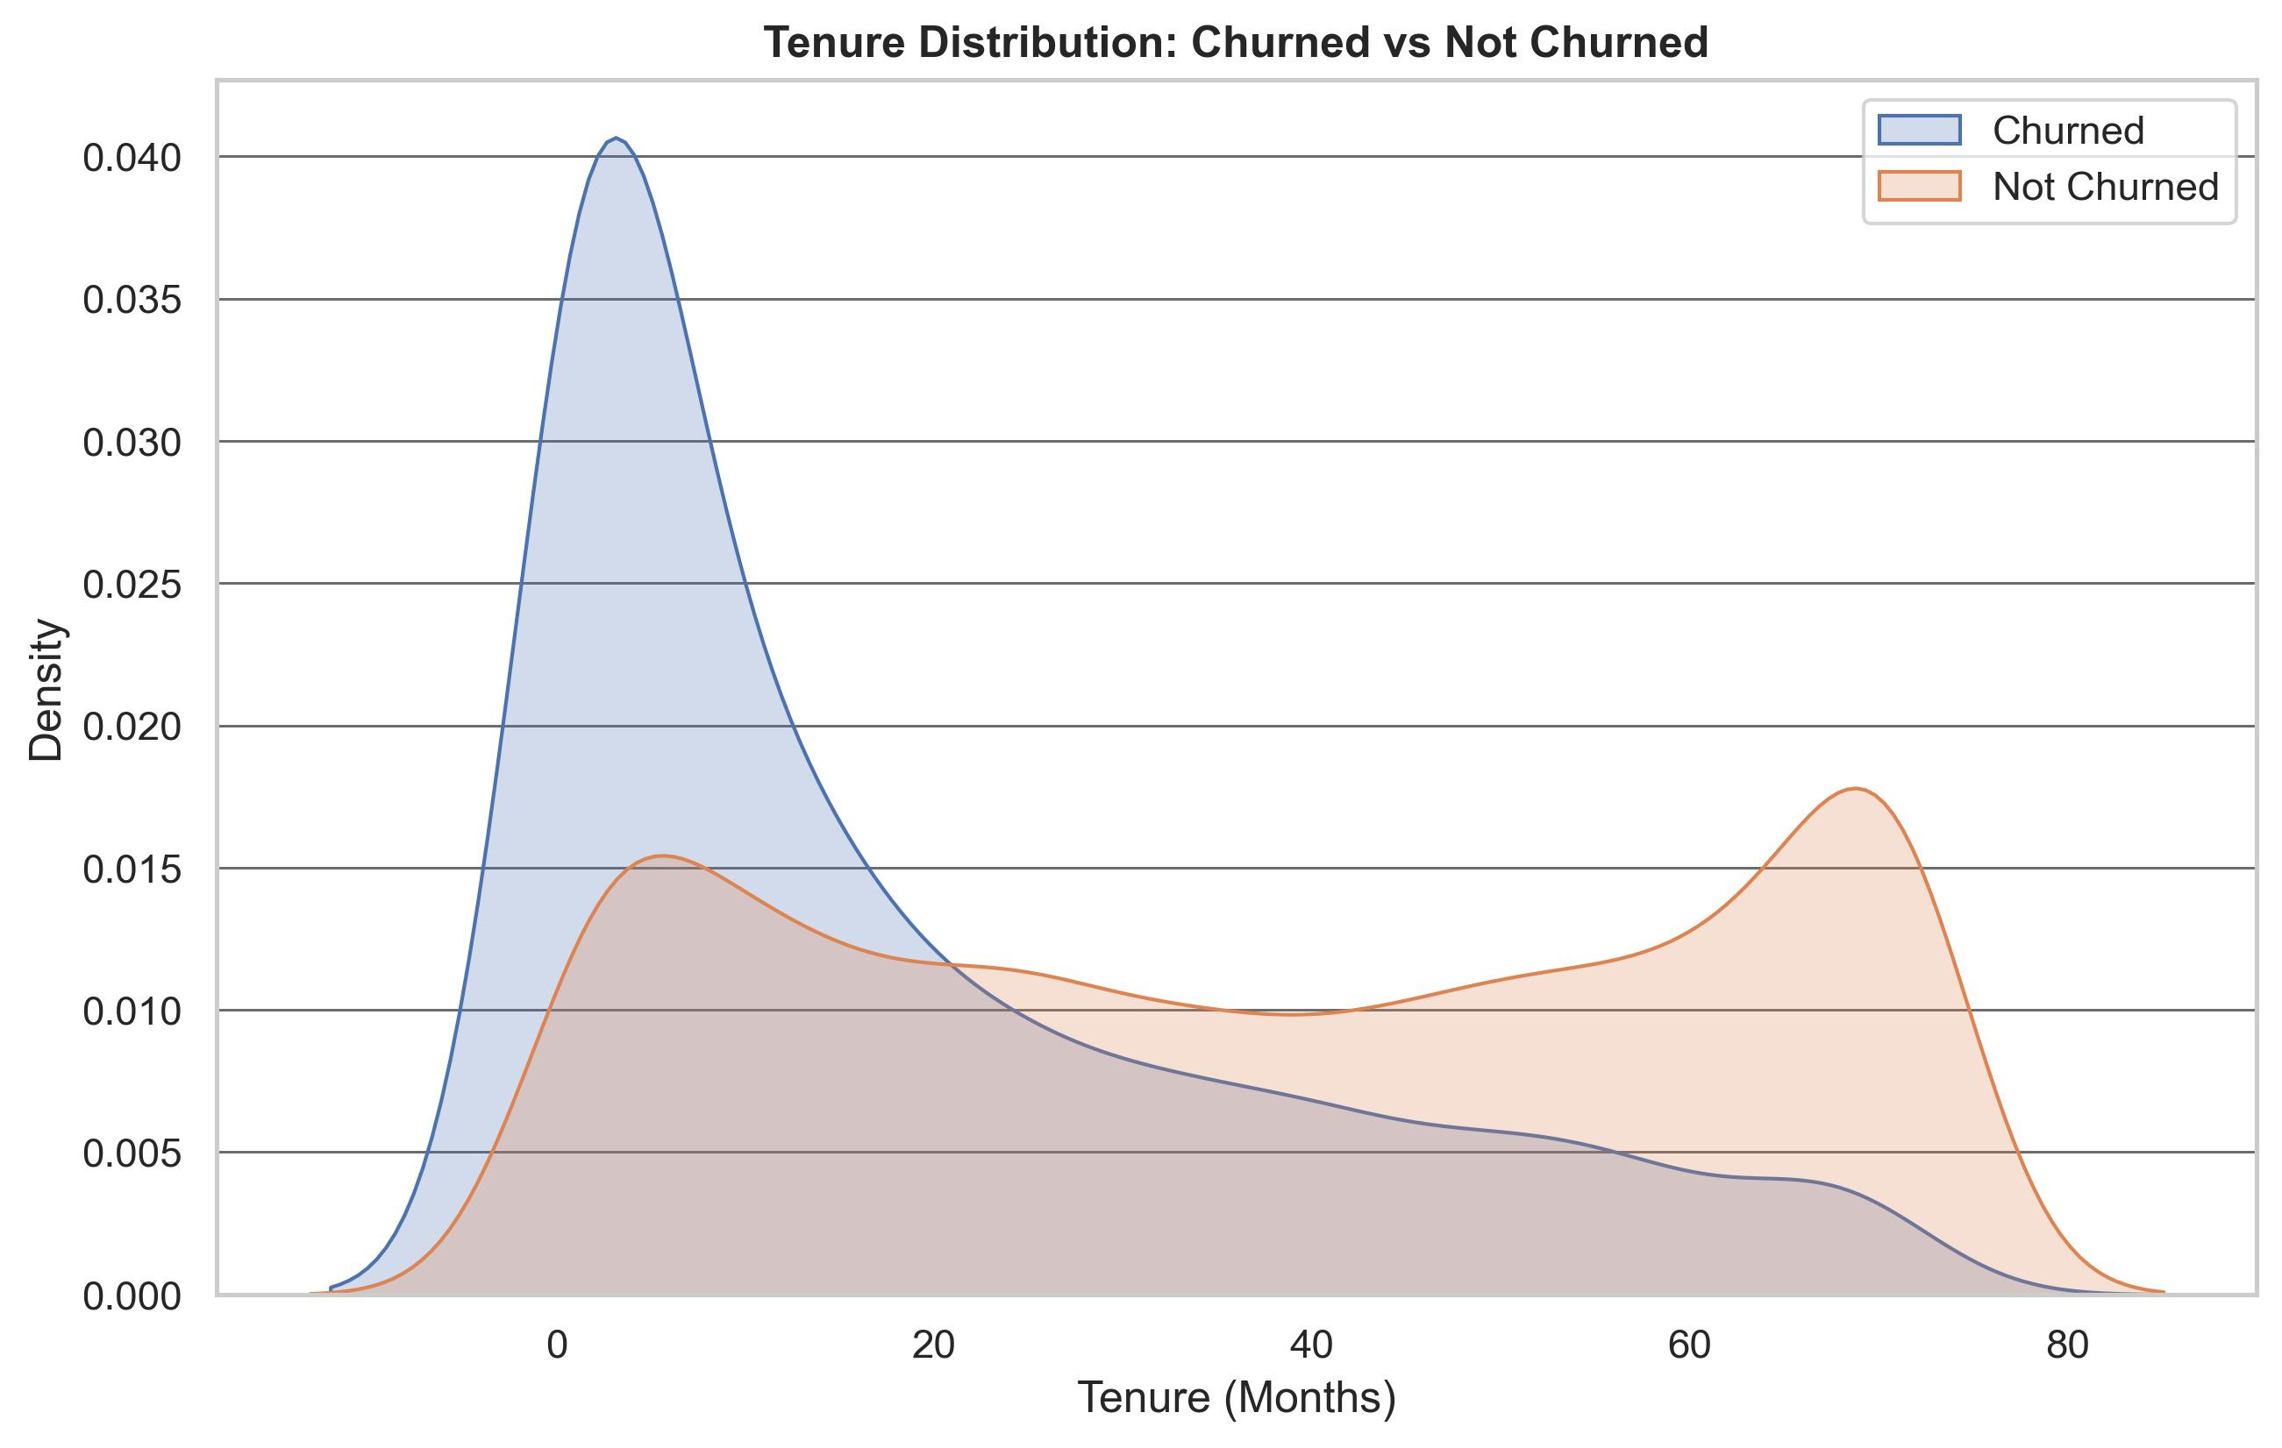
Home
Services
Features
About Us
Contact
Churn by Contract
Month-to-month contracts had highest churn
Exploratory Data Analysis (EDA)
Churn by Internet service Type
Churn by Tenure
Shorter tenures linked to higher churn
Customers using Fiber optic internet are churning at higher rates compared to those using DSL or no internet service.

Slide 7


Home
Services
Features
About Us
Contact
Models Trained
Model Building
Logistic Regression
Baseline Decision Tree
Optimized Decision Tree (GridSearchCV)
Train-Test Split
80-20
Evaluation Metric
Accuracy, Recall, ROC AUC

Slide 8
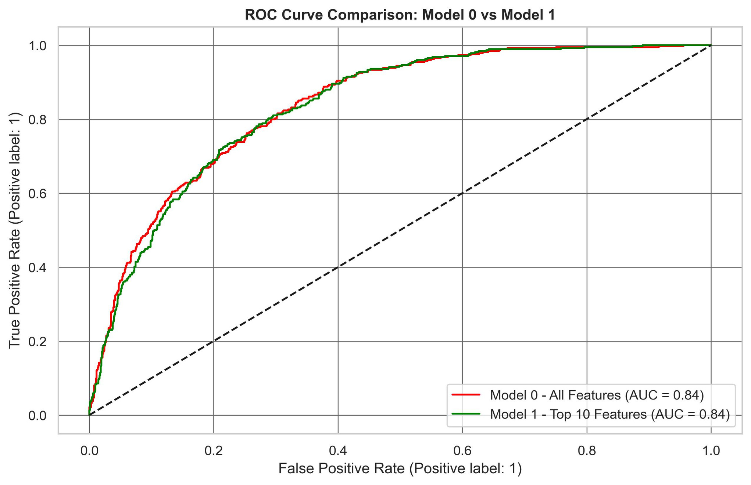
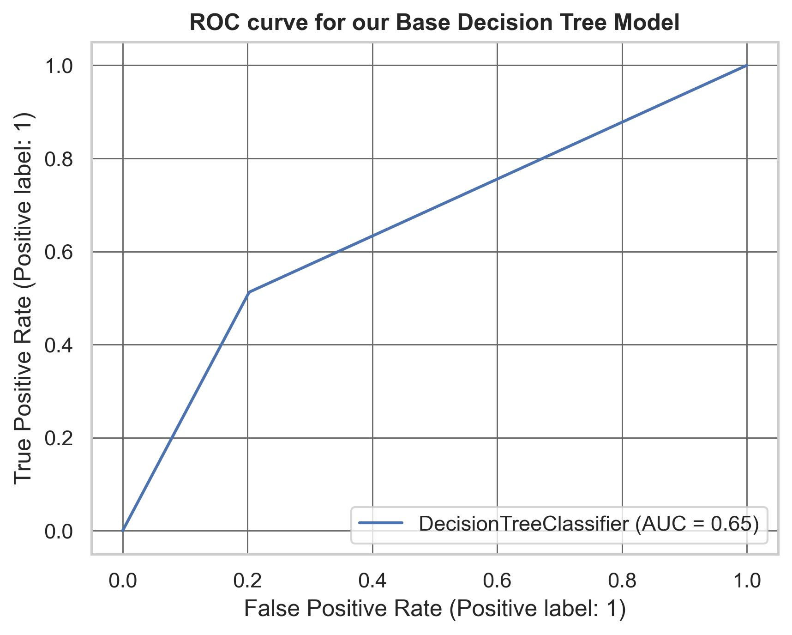
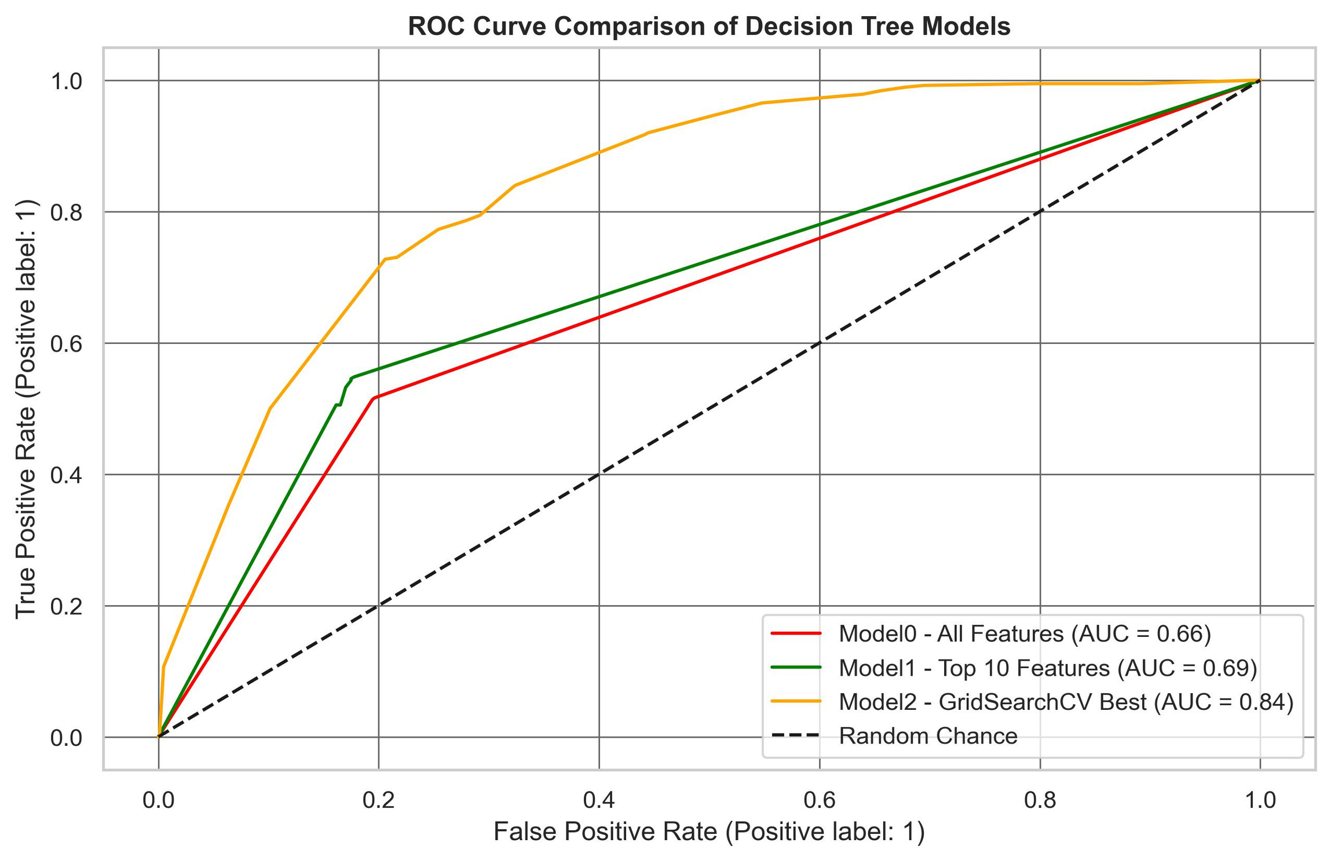
Home
Services
Features
About Us
Contact
Model Performance
Logistic Regression
Baseline Decision Tree
Optimized Decision Tree
Accuracy: 80%, Recall: 54%
Accuracy: 74%, Recall: 68%
Accuracy: 77%, Recall: 73%, ROC AUC: 0.83

Slide 9

Home
Services
Features
About Us
Contact
Feature Importance
Top Features
Contract
Tenure
InternetService
TechSupport

Slide 10
Home
Services
Features
About Us
Contact
Final Model Summary
Chosen Model
Key Insight
GridSearchCV-optimized Decision Tree
Improvements
Contract and customer engagement services are top churn drivers
Higher recall and ROC AUC
Better generalization to test data

Slide 11

Home
Services
Features
About Us
Contact
Conclusions
Churn is predictable using ML models
Support services and contract length significantly affect churn
GridSearchCV tuning led to better performance across all metrics

Slide 12

Home
Services
Features
About Us
Contact
Recommendations
Encourage long-term contracts with benefits
Invest in customer support and proactive outreach
Use the model to flag high-risk customers for retention campaigns

Slide 13


Home
Services
Features
About Us
Contact
Thank You
Get in touch
https://github.com/TonnieD
ngangaanthony31@gmail.com

